Slide 1
Putting the Human in Human Sciences: Towards Stronger FCS Messaging
Elizabeth Gregory North Mississippi State University Extension Service

Slide 2
Why do you do what you do?

Slide 5
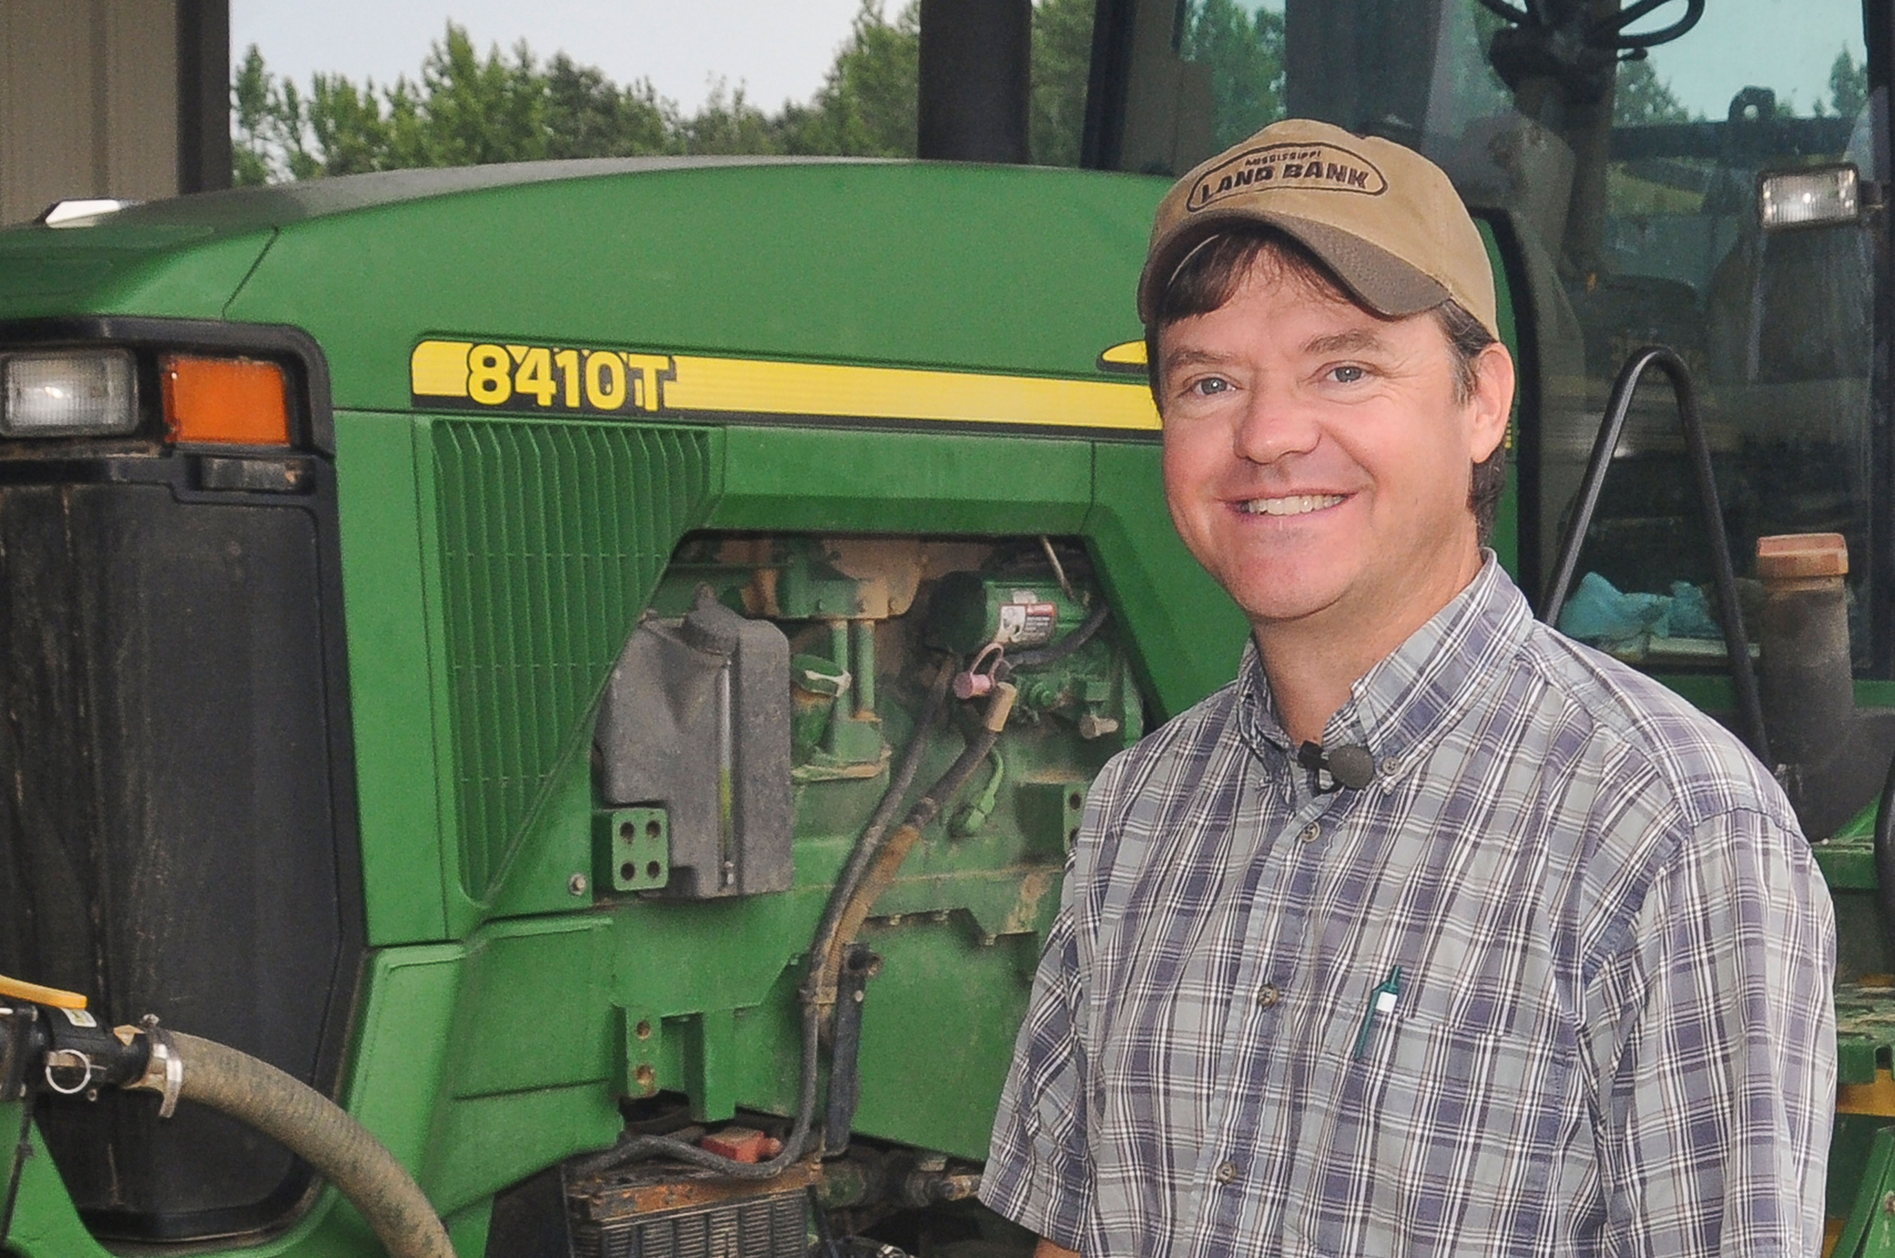

Slide 6
Your assets: resources for building better messages

Slide 7
The Living Well Campaign
Raising kids, eating right, spending smart

Slide 8
Contact your local office of the nationwide Cooperative Extension Service

Slide 9
Contact your local office of the nationwide Cooperative Extension Service

Slide 10
Contact your local office of the nationwide Cooperative Extension Service

Slide 11
What your clients and partners say
I never thought my kids would eat vegetables. Now they even like them for snacks! EFNEP client
The ladies in the EFNEP classes are managing their food stamps so well that they haven’t needed emergency food assistance. Agency coordinator

Slide 12
What your clients and partners say
I have bragged and bragged about my wife. Last year we bought our Thanksgiving dinner at the grocery store. This year, she made us a feast with all the trimmings, gravy and everything. I am so proud of her! Husband of EFNEP client

Slide 13
What your clients and partners say
Our speaker today was a teen mom just like me, but she has accomplished a lot. That gave me hope. EFNEP youth client

Slide 14
Strong impact data: reasons to believe
Your state and federal reports
Your program evaluations
landgrantimpacts.org

Slide 15
Your professional communicators
Your communicators at your own institution
The members of the PLN Communications Committee

Slide 16
Lessons from advertising

Slide 17
Boring marketing language
Content
Meaning
Features of our product.
What we do.

Slide 18
Better marketing language
Content
Meaning
Benefits to the customer.
What’s in it for you.

Slide 19
Best marketing language
Content
Meaning
The customer’s experience.
What your life will be like.

Slide 20
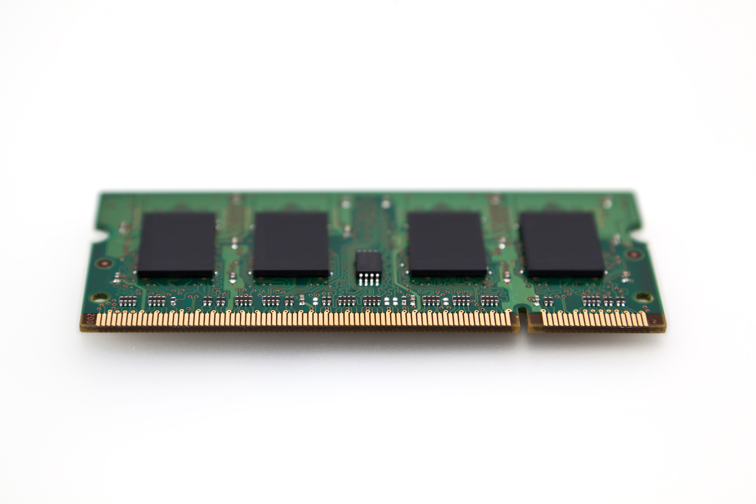
Our mp3 player has storage for 1 GB of mp3s. It weighs only 6.5 ounces and offers long battery life and fast transfer speeds.

Slide 21
iPod: 1,000 songs in your pocket.

Slide 22
Best approach for Extension FCS: accountability communications
Combine
High-quality impact and evaluation data (quantitative) with
High-quality quotes, photos, and stories of the real people whose lives have changed because of FCS

Slide 23
Best approach for Extension FCS: client recruitment
High-quality quotes, photos, and stories of the real people whose lives have changed because of FCS.
Help them see themselves in the programs.
Inspire them to imagine what their lives can be like.

Slide 24
Write your own ad

Slide 25
First: Identify your audience. Choose only ONE!
Extension clients, or end users
Potential partners
Elected officials
Grantors
Others?

Slide 26
Second: Assemble your ideas
AIDA formula
Something to grab their ATTENTION.
Something to hold their INTEREST.
Something to inspire DESIRE.
A clear call to ACTION.

Slide 27
Third: Write it down and turn it in!
Does it have all the elements?

